Slide 1



Roadmap (2026+)
PEPR SOUS-SOL - #DIGITAL EARTH

Slide 2
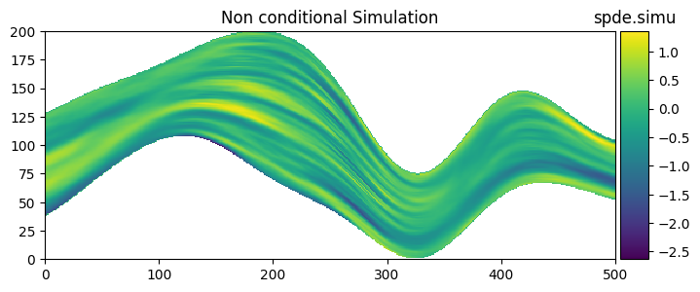


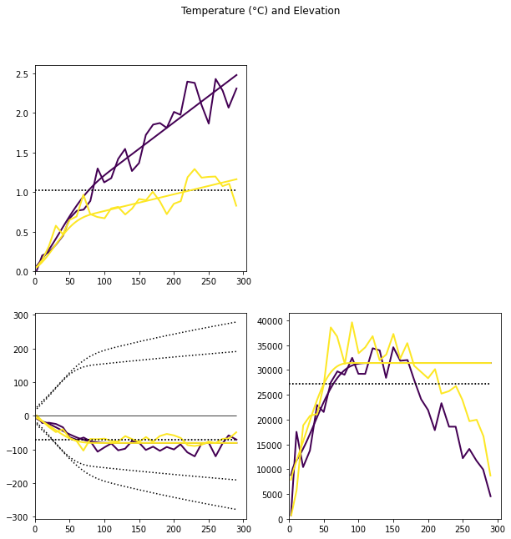
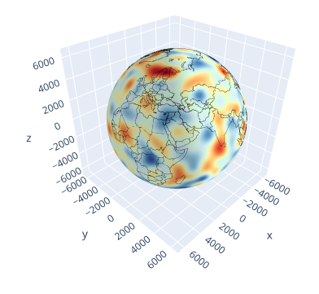

Ambitions
World Reference for Geostatistical Package (R/Python)
Most Complete Set of Features for ST Data Analysis
Our Most Advanced Research Showcase
Robust and Efficient
Easy to Use
Scalable
Platform Agnostic (Windows, Linux, Mac OS)
Interoperable with other Packages

Slide 3
Project Roadmap
2022:
Beta version (C++, Python, R) (github repository)
CI/CD (Continuous Integration / Continuous Deployment)
2023:
Software Registering at APP
On-line help (C++ only) & Website (gstlearn.org)
Distribution Plan & Open-source (public repo)
2024:
Python New Dependency: Numpy 2
C++ 17 => C++ 20
R Package (minigst)
Mac Portability (Intel / Apple Silicon)
2025 …
Multi-Threading
Python 3.14 & R 4.5 Compatibility
September 2023
Journées de Géostatistique
July 2024
Geolearning Meeting #1
April 2025 Geolearning Meeting #2
Scalability / Optimization / Robustness

Slide 4

Project Roadmap
… 2025:
Python package (minigst)
Namespace + Integers 64 bits
PlayKrige (Marimo)
Diagnostic Tools (Error Messages, Deprecated Functions)
Publication (Akanbi et al., IntechOpen, 2025)
New API (SPDE, Matrices, Potential, …)
2026:
In-line documentation
GUI / Plugins (QGis, Paraview, …)
Governance / Contributing
Users meeting #1
October 2025
PEPR Sous-Sol – Digital Earth WP4 - #1
March 2026
Today
Scalability / Optimization / Robustness

Slide 5
Features Roadmap
2022:
Classical Geostatistics (RGeostats Scope)
2023:
SPDE API / Non-Stationarity
Neighborhood (Faults, Extension)
2024:
Optimized Linear Algebra (Eigen)
Likelihood Maximization / Optimization (Nlopt)
Space-Time Model: Covariance Refactoring
2025 …
Space/Time Model: Kriging and Simulation
HDF5 Serialization
Vecchia Likelihood Approximation (for Big Dataset)
Multivariate Gneiting with Advection
Transformed Gaussian Models with Few Parameters (Yeo-Johnson)
September 2023
Journées de Géostatistique
July 2024
Geolearning Meeting #1
April 2025 Geolearning Meeting #2
Scalability / Optimization / Robustness

Slide 6
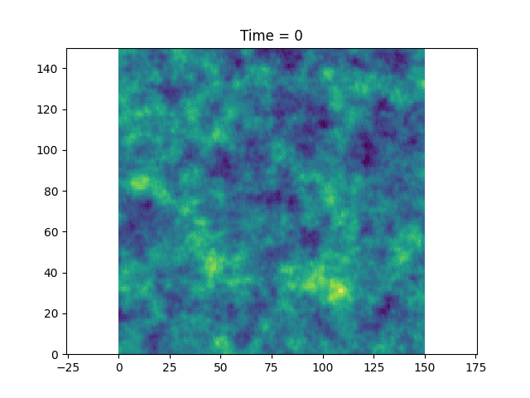
Multivariate Gneiting with Advecion

Slide 7
Features Roadmap
… 2025:
SPDE: Multivariate (LMC) + Abstraction for Conditioning (geophysics or gradients data)
Automatic Differentiation for Gradient-Based Algorithms (i.e. LBFGS) in Nlopt
Non-Proportional Model (Multivariate Mattern & Cauchy) – different scope/regularity per variable
2026:
Multigrid Preconditioner
Inference of Non-Proportional Models
Auto-Diff for Vecchia Approximation
Extrema Models
Study Serialization / Data Streaming
Customizable Nested Covariance Model
Multi-spaces (Lines, Graphs)
Cloud-ready / GPU-ready
October 2025
PEPR Sous-Sol – Digital Earth WP4 - #1
March 2026
Today
Scalability / Optimization / Robustness

Slide 8

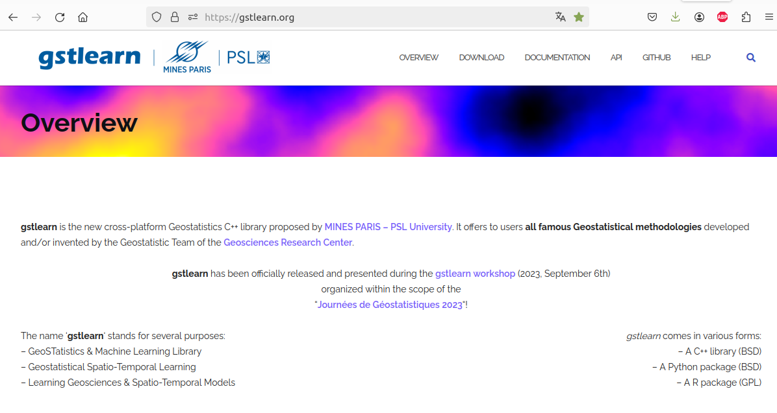



webSITE & LicenSes
URLs around
https://gstlearn.org
https://github.com/gstlearn/gstlearn
https://pypi.org/project/gstlearn
https://soft.mines-paristech.fr/cran/gstlearn.html
https://doi.org/10.5281/zenodo.18352742
C++ BSD3
Pypi
CRAN
BSD3
GPL3
https://github.com/gstlearn/minigst

Slide 9
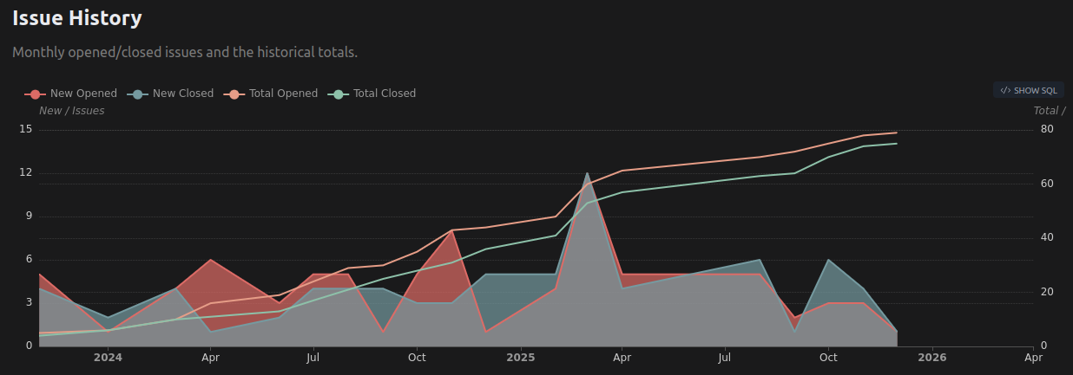
Repository insights
https://github.com/gstlearn/gstlearn/graphs/contributors
https://github.com/gstlearn/gstlearn/graphs/traffic
https://ossinsight.io/analyze/gstlearn/gstlearn

Slide 10
JURIDIC ASPECT / Governance
Contributions:
Any author with a github account
By pull requests on github repo only
Accepted only if the proposed license is compatible
If no license is proposed, keep BSD-3 (by default)
Intellectual property to the author (by default)
Keep trace of the author in the source (comments)
Responsibility:
Software is provided as-is (no warranty)
MINES Paris is not responsible for authorship property errors
Source Code:
License: BSD 3-clause (Open-Source, no restriction)
IP (Intellectual Property): MINES Paris
Except some portions of code (see below)
Core Team missions:
Roadmap (features, issues, release)
Code reviews (pull requests, merge)
License policy / Web site / Governance rules

